Slide 1

Software Design and architecture (SE322) gg
Week 05
Said Nabi
said.nabi@giki.edu.pk
Faculty of Computer Science and engineering
Gik Institute Topi, Swabi

Slide 2
List of Topics
Design patterns (Creational, Structural, Behavioral)

Slide 3
Design Patterns
In software engineering, design problems often repeat. While many solutions exist, the industry prefers flexible and reusable ones — known as design patterns.
A design pattern is a proven solution to a recurring design problem. It reuses solutions from expert developers, saving time and avoiding starting from scratch. These patterns are widely used in industry and can also help untangle messy spaghetti code.
These design solutions are not theoretical proposals of only academic interest. These are actual solutions that are used in industrial software

Slide 4

Design Patterns Cont…
Design patterns are like recipes in a cookbook—
Tested and refined over time. Just as a recipe become
Preferred for producing the best dish, design patterns are proven solutions developers use to achieve the best outcomes.

Slide 5

Design Patterns Cont…
Choosing the right design pattern isn’t always obvious since many exist. It’s like chess
—there are many possible moves and strategies, and experience helps in making the best choice
Like chess, selecting the right design pattern improves with practice and experience.
Beginners may only know the basics, but over time developers learn to choose the right patterns, and some even become experts at solving design problems efficiently.

Slide 6
Design Patterns Cont…
A key advantage of design patterns is that they are expert-proven, so you can focus on writing better software without repeating their trials.
They also create a shared design vocabulary—pattern names make it easier to discuss solutions, save time, and reduce misunderstandings.
We’ll use an Observer Pattern is much quicker than explaining: “Object A needs to be notified every time object B changes”.
Design patterns serve almost like a coach to help developers reach their full potential!
Learn the names, purposes, and use cases of common patterns—it makes teamwork and code reviews smoother.

Slide 7
Design Patterns Cont…
Design patterns aren't code you memorize and plug in; they're conceptual solutions to common software problems.
Design patterns are a guide for software developers to solve common design problems, making their software more flexible and reusable.
They help developers structure their code and avoid building everything from scratch.
With time and experience, you’ll recognize which pattern fits a problem best.

Slide 8
Design Patterns Cont…
One of the most famous references is GOF: Elements of Reusable Object-Oriented Software by Gamma, Helm, Johnson, and Vlissides, which this course draws upon.
Based on their experiences as developers, the authors, known as the "Gang of Four," noticed repeating design solutions in their software.
They collected and organized these common solutions into a formal reference book.
This collection of named patterns became the Gang of Four's design pattern catalog.

Slide 9



Design Patterns Cont…
This catalog is not like a recipe book... Instead, it's closer to a list of tropes.

Slide 10
Patterns Language
A collection of patterns that are related to a certain problem space is called a Pattern Language.
A Pattern Language is a group of patterns tailored to a specific domain or problem context
Pattern language of game design will be different from that of accounting software.
Choosing the correct pattern language is like choosing the right spoken language.
You wouldn’t speak Spanish in a room full of Mandarin speakers. Similarly, your design choices must match your problem space.

Slide 11
GoF Design Patterns
There are three categories of design patterns outlined by the Gang of Four:
Creational Patterns:
Creational Patterns tackle how you handle creating new objects.
Singleton Pattern, Prototype Pattern, Factory Method Pattern, Abstract Factory Pattern
Structural Patterns:
Structural patterns focus on how classes and objects are composed to form larger structures.
Adapter Pattern, Composite Pattern, Decorator Pattern, Facade Pattern
Behavioral Patterns:
Behavioral patterns define how objects communicate, distribute responsibilities, and work together.
Observer Pattern, Strategy Pattern, Command Pattern, Chain of Responsibility Pattern

Slide 12
Why Learn Design Patterns
Pros
Patterns will help you as a designer to develop an intuition for and appreciate object-oriented design
Helps you recognize common solutions
Promotes modular and maintainable code
Speeds up team communication using a common vocabulary
Helps you analyze trade-offs between different design choices
Cons
Some patterns may be more resource-intensive.
No pattern is perfect for every situation
Patterns can increase complexity, use more memory, or reduce performance
The key is to understand when and where to use each pattern

Slide 13
Singleton Design Patterns (Creational)
Singleton is a creational pattern which describes a way to create an object.
The Singleton Pattern ensures that only one instance of a particular class exists in a program and that it is globally accessible.
Prevents multiple conflicting instances
Provides a single point of access to a resource
Let’s say you’re working on a mobile app where the user can play poker.
You have a Preferences class to store user settings (e.g., table color, card back design).

Slide 14
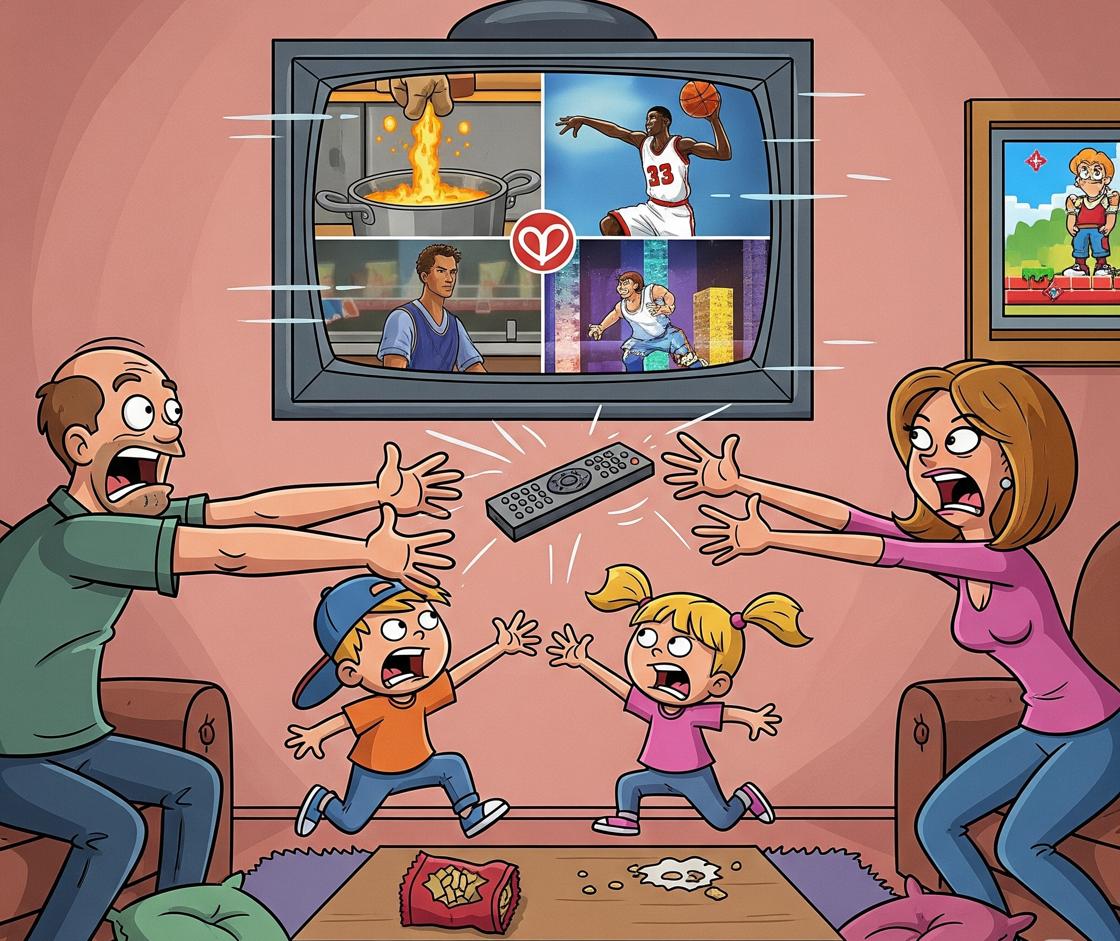
Singleton Design Patterns (Creational)…
Problem:
If multiple instances of Preferences exist:
One instance might save red card backs
Another shows blue card backs
This causes inconsistency and bugs.
Solution:
Use Singleton to ensure that:
Only one Preferences object exists
That object is used throughout the app

Slide 15
How to Implement Singleton
Another goal of the Singleton design pattern is that the single object is globally accessible
Just promise yourself not to create another object
This is error-prone, especially in large teams
Enforce Singleton behavior through code. That way, even accidental attempts to create multiple instances are blocked
If you have a class with a public constructor... any part of the code can create another object.
A public constructor allows multiple objects
Solution Make the constructor private so that it can’t be called from outside the class.

Slide 16
How to Implement Singleton Cont…
Another goal of the Singleton design pattern is that the single object is globally Declare a class variable called uniqueInstance.
This variable stores the one and only object
Declare it as private static within the class
private static Preferences uniqueInstance;
Create a public method that will create an instance of the class only if one doesn’t already exist.
What it does:
Checks if uniqueInstance is null
If yes → creates the object
If no → returns the existing object
public static Preferences getInstance() {
if (uniqueInstance == null) {
uniqueInstance = new Preferences();
}
return uniqueInstance;
}

Slide 17
Lazy Instantiation
Another advantage... the object is not created until it is truly needed. This is called lazy creation.
Saves memory
Speeds up startup time
Useful for large or resource-heavy objects
If there are multiple computing threads. issues could arise.
Design patterns are defined by their purpose or intent, and not the exact code
Regardless of the language or exact implementation, the intention is always:
Only one object
Globally accessible

Slide 18
Examples
There are many objects that we would like only one of
App preferences/settings
Printer spooler / print queue
Logger class
Database connection manager
It can be a powerful technique on its own, or in combination with other design patterns.
Singleton is often used alongside other patterns like:
Factory: A factory that returns a singleton object
Facade: A facade that hides a Singleton backend
Observer: A singleton subject being observed

Slide 19






Factory Method Design Pattern
Just like a factory in the real world, the purpose of these factories in object-oriented programming is to create objects.
In object-oriented programming, factories help us separate object creation from business logic. This makes code easier to manage, modify, and extend.
We’ll examine:
Simple Factory
Factory method
Abstract Factory

Slide 20
A Knife Store
You sell multiple types of knives: SteakKnife, ChefsKnife, etc.
You have a superclass: Knife
With subclasses like SteakKnife and ChefsKnife.
The system uses conditional logic to decide which specific subclass to create, for example, new ChefsKnife().
This direct creation using the new operator is what's known as concrete instantiation.
As your store grows:
More knife types (BreadKnife, ParingKnife, or FilletKnife) = more conditionals in orderKnife()
However, the methods of the knife, such as Identifying, sharpening and packaging, would likely stay the same, no matter the type of knife.
Directly creating knives (objects) within the store's main logic is complicated. It's better to delegate this creation process to a separate Factory object.

Slide 21
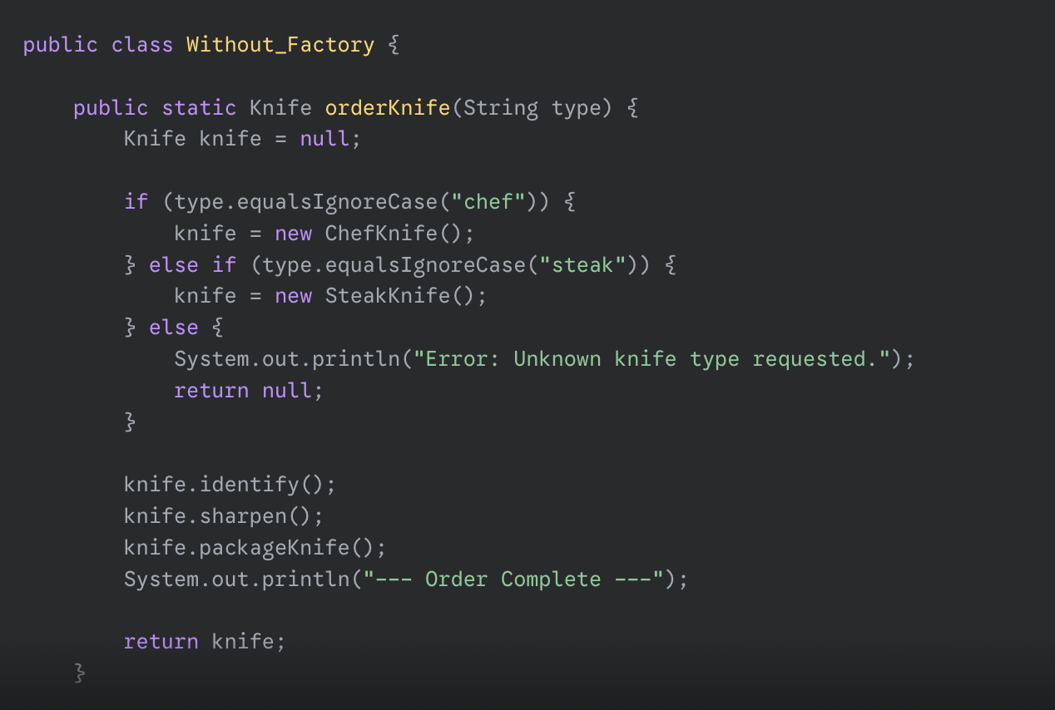
Example
Knife
SteakKnife
Chef Knife

Slide 22
Factory Object
A Factory Object is a dedicated object that creates other objects.
To simplify, in this knife-making example, the orderKnife method will no longer create the knife itself. Instead, it will delegate that task to a KnifeFactory object.
The KnifeFactory will contain all the logic for deciding which specific type of knife to create (SteakKnife, ChefsKnife, etc.).
The orderKnife method, however, will still handle other tasks like sharpening, Identifying, and packaging, allowing it to focus on its primary role. This separation of duties makes the code cleaner and more manageable.

Slide 23




Simple Factory
Knife
Identifying()
Sharpening()
Packaging()
Knife Factory
Create Knife(type){
}
SteakKnife
Chef Knife
Identifying(){}
Sharpening(){}
Packaging(){}
Identifying(){}
Sharpening(){}
Packaging(){}

Slide 24



Simple Factory’s UML
A factory class which decides which concrete class to instantiate is called factory.
<<interface>>
Product
Factory
Concrete
Product

Slide 25
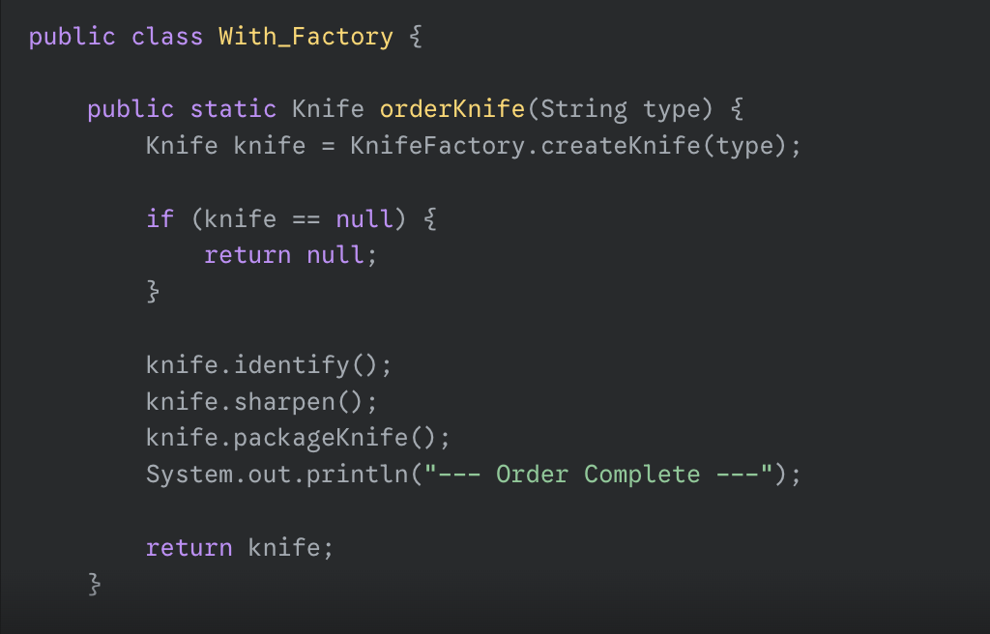
How it works
Before
The orderKnife() method:
Used conditionals to instantiate the correct subclass (e.g. new
ChefsKnife())
After
Creation is moved to a KnifeFactory class
KnifeStore becomes a client of KnifeFactory
// Inside KnifeFactory

Slide 26




Simple Factory
Knife
Identifying()
Sharpening()
Packaging()
Knife Factory
Create Knife(type){
}
SteakKnife
Chef Knife
Identifying(){}
Sharpening(){}
Packaging(){}
Identifying(){}
Sharpening(){}
Packaging(){}

Slide 27





Factory Method
Defines an interface for creating objects but allows derived classes to decide which class to insatiate.
Knife
<<interface>>
Knife Factory
Identifying()
Sharpening()
Packaging()
Create Knife(type);
H_SteakKnife
H_SteakKnife
L_SteakKnife
L_Chef Knife
Identifying(){}
Sharpening(){}
Packaging(){}
Identifying(){}
Sharpening(){}
Packaging(){}
Identifying(){}
Sharpening(){}
Packaging(){}
Identifying(){}
Sharpening(){}
Packaging(){}
HighBudgetKnife
LowBudgetKnife
Create Knife(type){}
Create Knife(type){}

Slide 28











Abstract Factory Method
<<interface>>
Sheath
FitKnife();
InspectMaterial();
Knife
<<interface>>
Knife Factory
Identifying()
Sharpening()
Packaging()
L_B_ Sheath
H_B_Sheath
FitKnife(){}
InspectMaterial(){}
FitKnife(){}
InspectMaterial(){}
Create Knife(type);
Create Sheath(type);
H_SteakKnife
H_SteakKnife
L_SteakKnife
L_Chef Knife
Identifying(){}
Sharpening(){}
Packaging(){}
Identifying(){}
Sharpening(){}
Packaging(){}
Identifying(){}
Sharpening(){}
Packaging(){}
Identifying(){}
Sharpening(){}
Packaging(){}
HighBudgetKnife
LowBudgetKnife
Create Knife(type){}
Create Knife(type){}
Create Sheath(type){}
Create Sheath(type){}

Slide 29
Benefits of Factory Objects
Adding new object types is much simpler because you only need to modify the factory, not the multiple places in the client code where the objects are used. This reduces redundant code and centralizes changes.
Factories allow client code to interact with an object through a generalization (e.g., a Knife interface) rather than a specific class (e.g., ChefsKnife). This is known as coding to an interface, not an implementation. As long as the factory provides the expected object type, the client code doesn't need to know the details of its creation.
Essentially, a factory object eliminates redundant creation code and makes software easier to modify, especially when the same objects are needed in multiple places. It's like a real-world factory: the store doesn't care how the knife is made, as long as it gets the right product.

Slide 30
Thank You☺

